Slide 1

"MEdCitI"
We Care Your Lives
By: TechnoCrats

Slide 2

TABLE OF CONTENTS:
Introduction
UseCase
Project Architecture
Android App
Website
BackEnd Design
DB Structures

Slide 3
Introduction "MedCiti"– The pharmacy management system is a pharmacy's Use only application which enables the users to manage and maintain internal systems and operations.

Slide 4
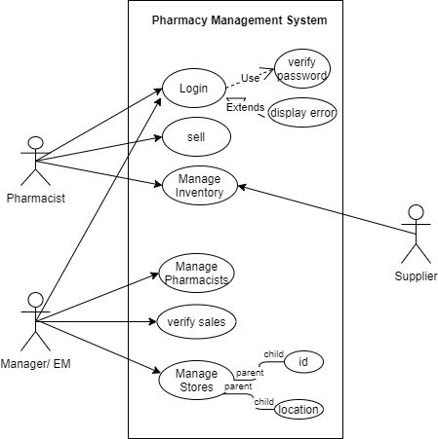
uSEcASE

Slide 5
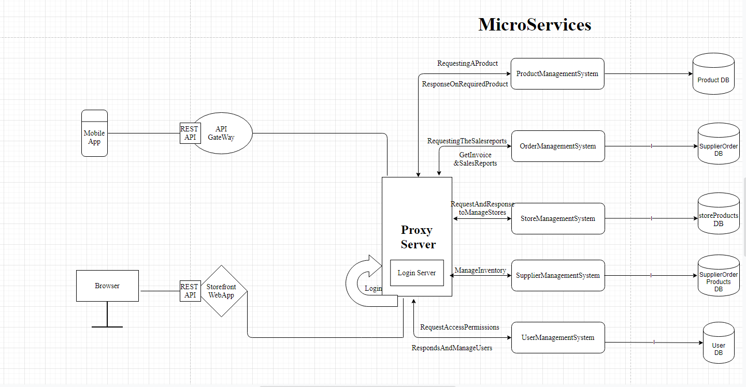
Project Architecture

Slide 6
MOBILE APP

Slide 7
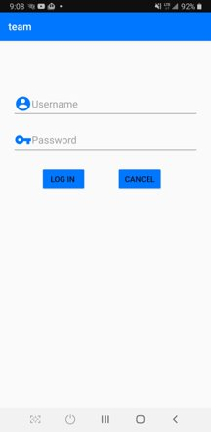
User login

Slide 8
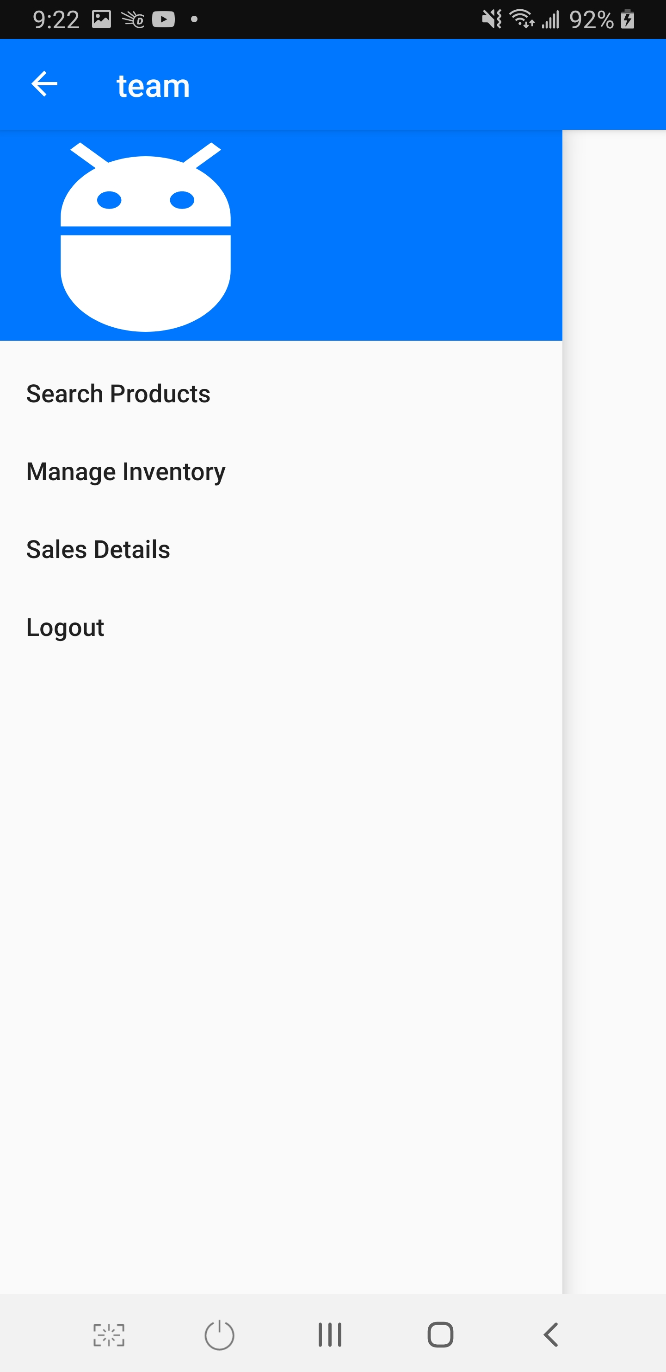
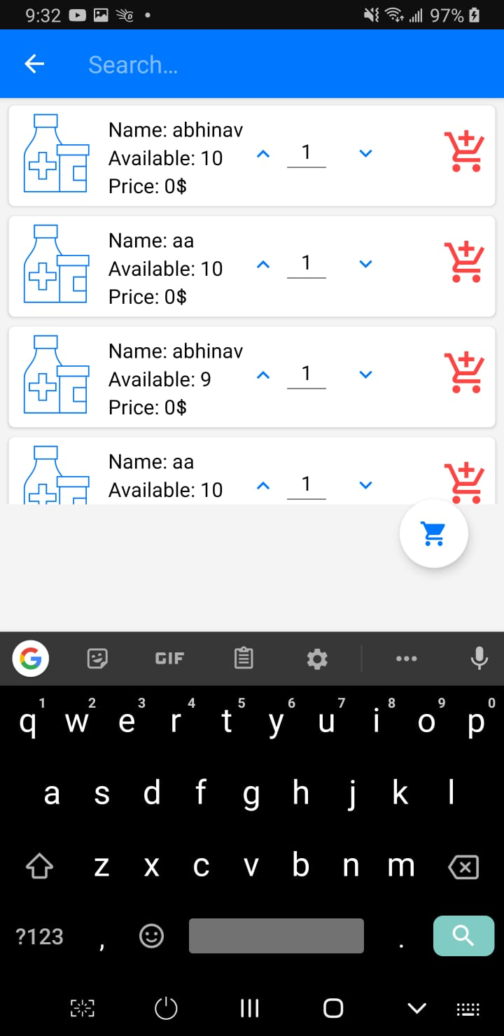
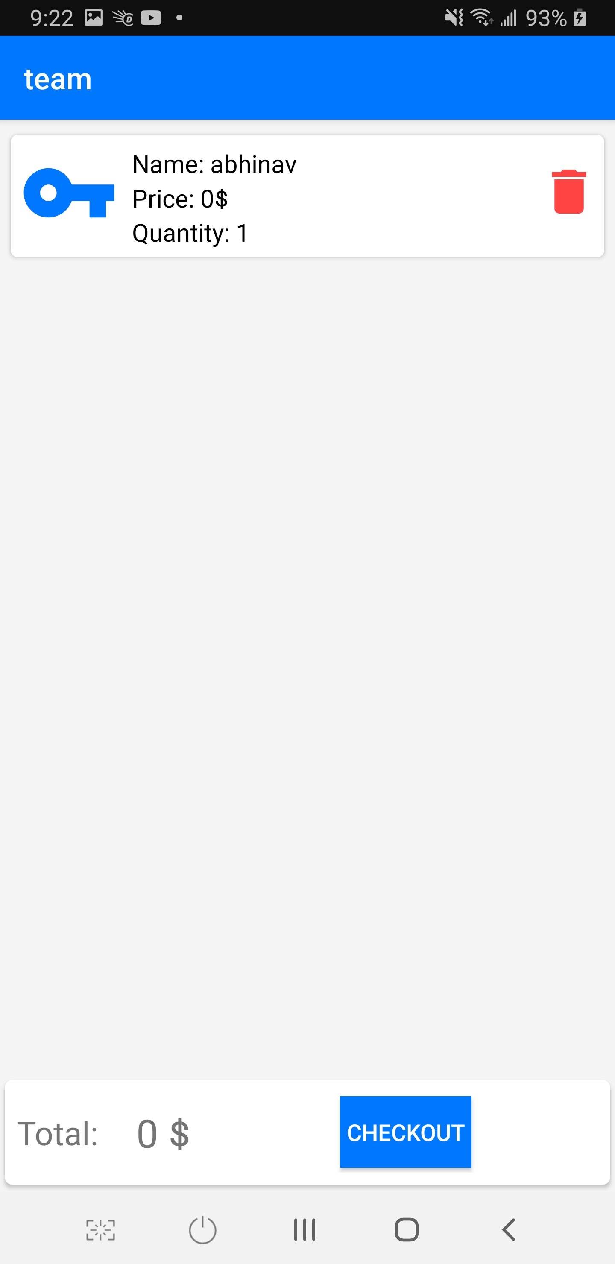
Pharmacist Login

Slide 9

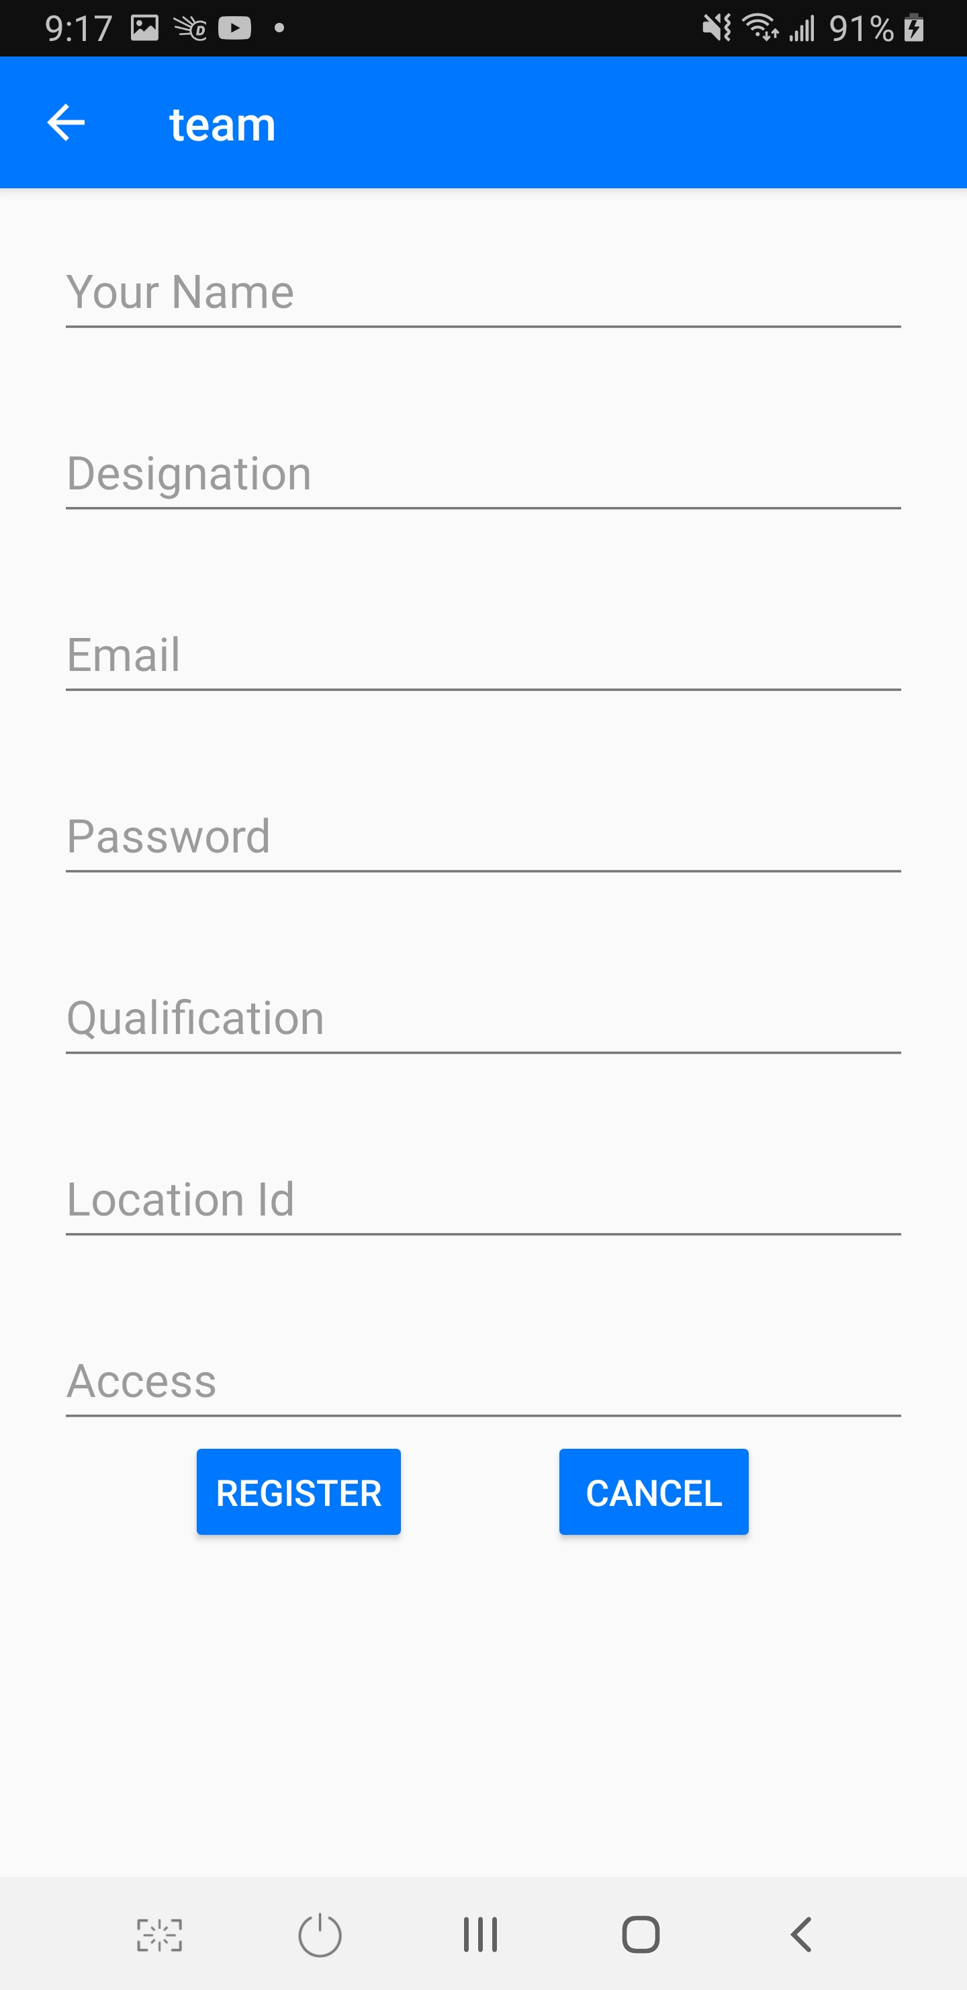
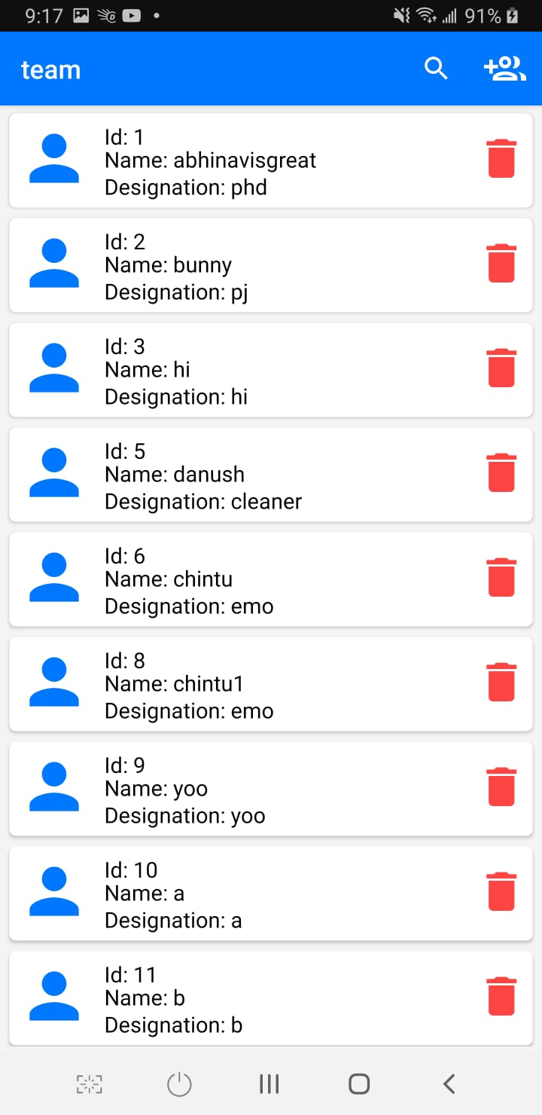
The Admin

Slide 10
THE WEBSITE

Slide 11
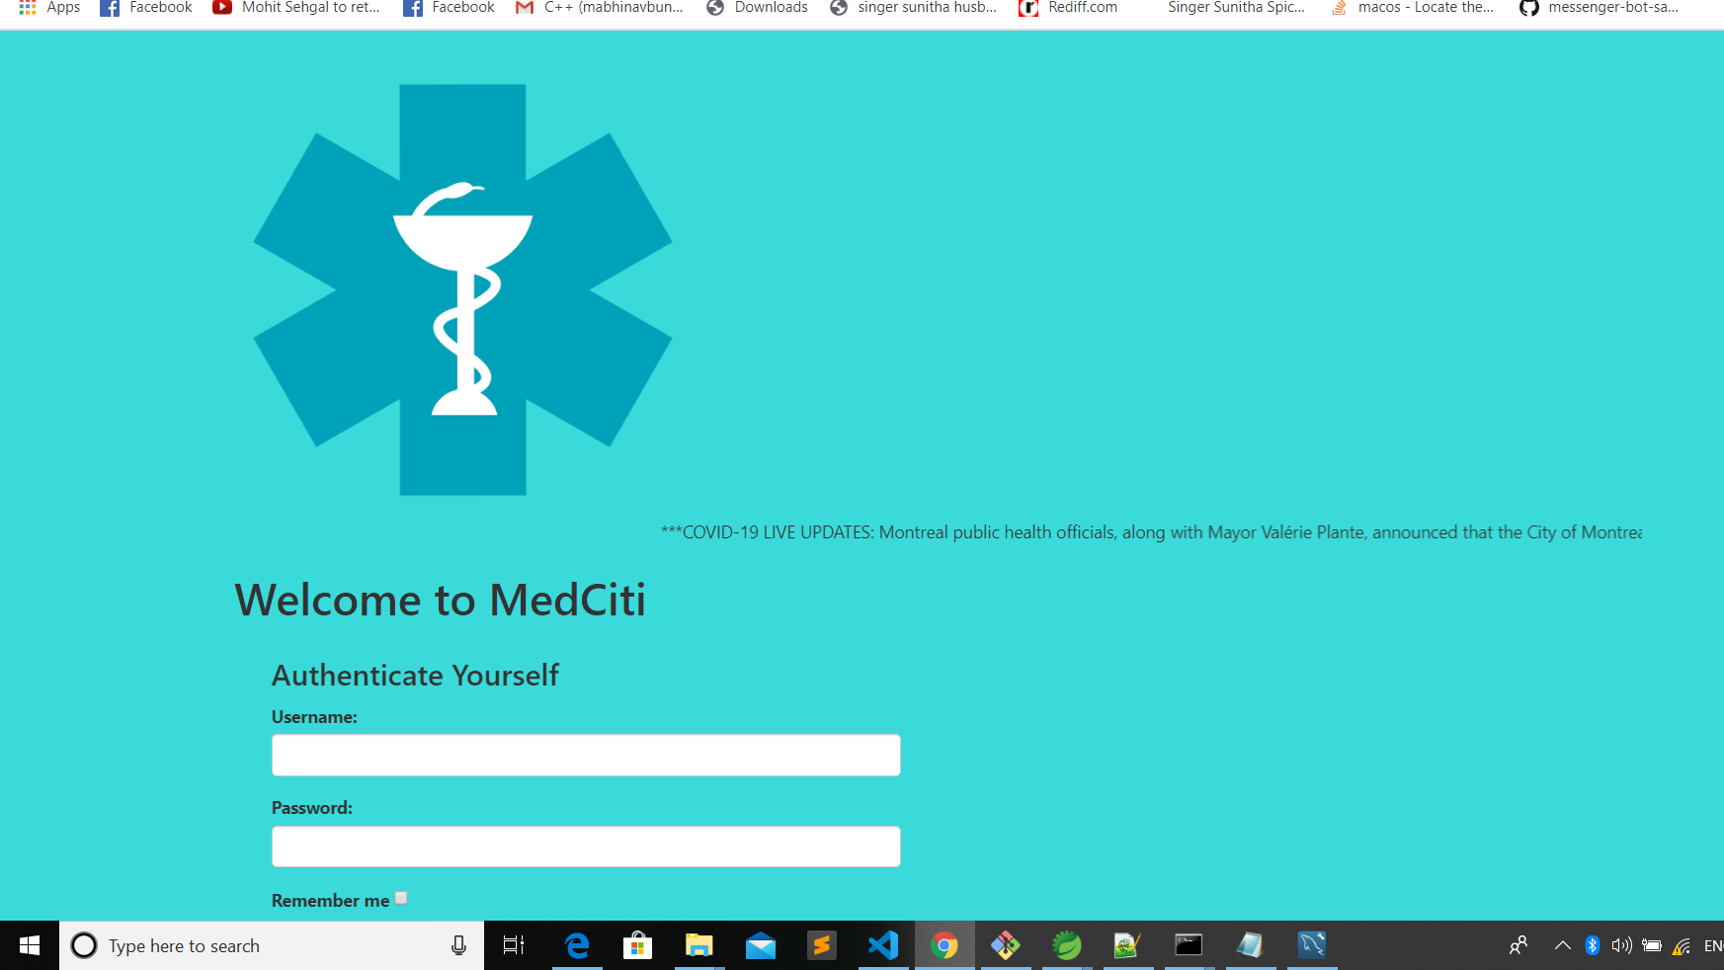
Login page

Slide 12
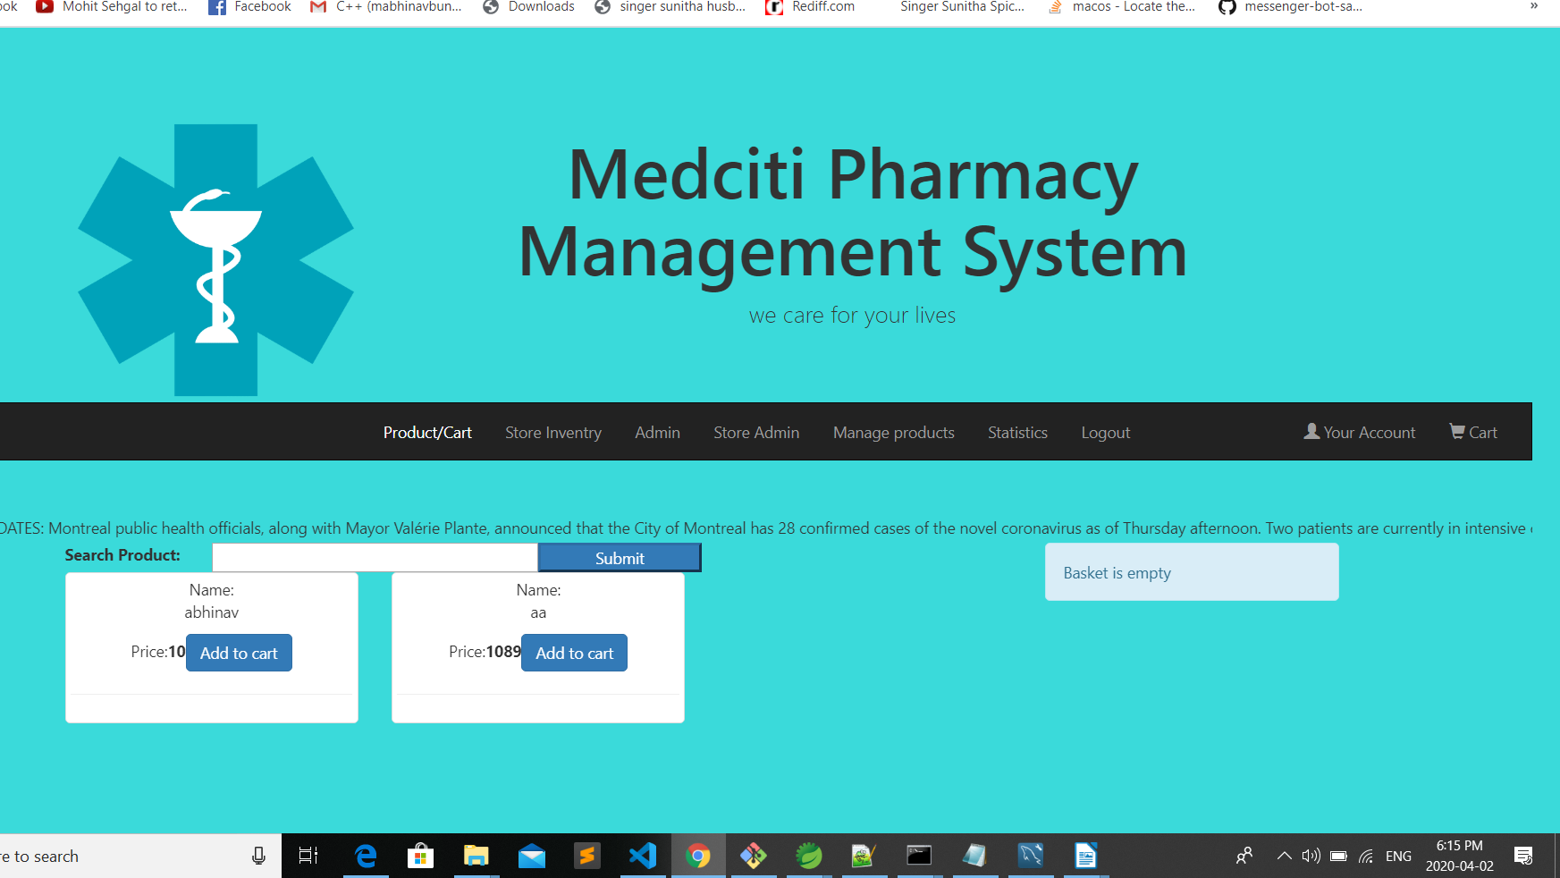
Pharmacist page

Slide 13
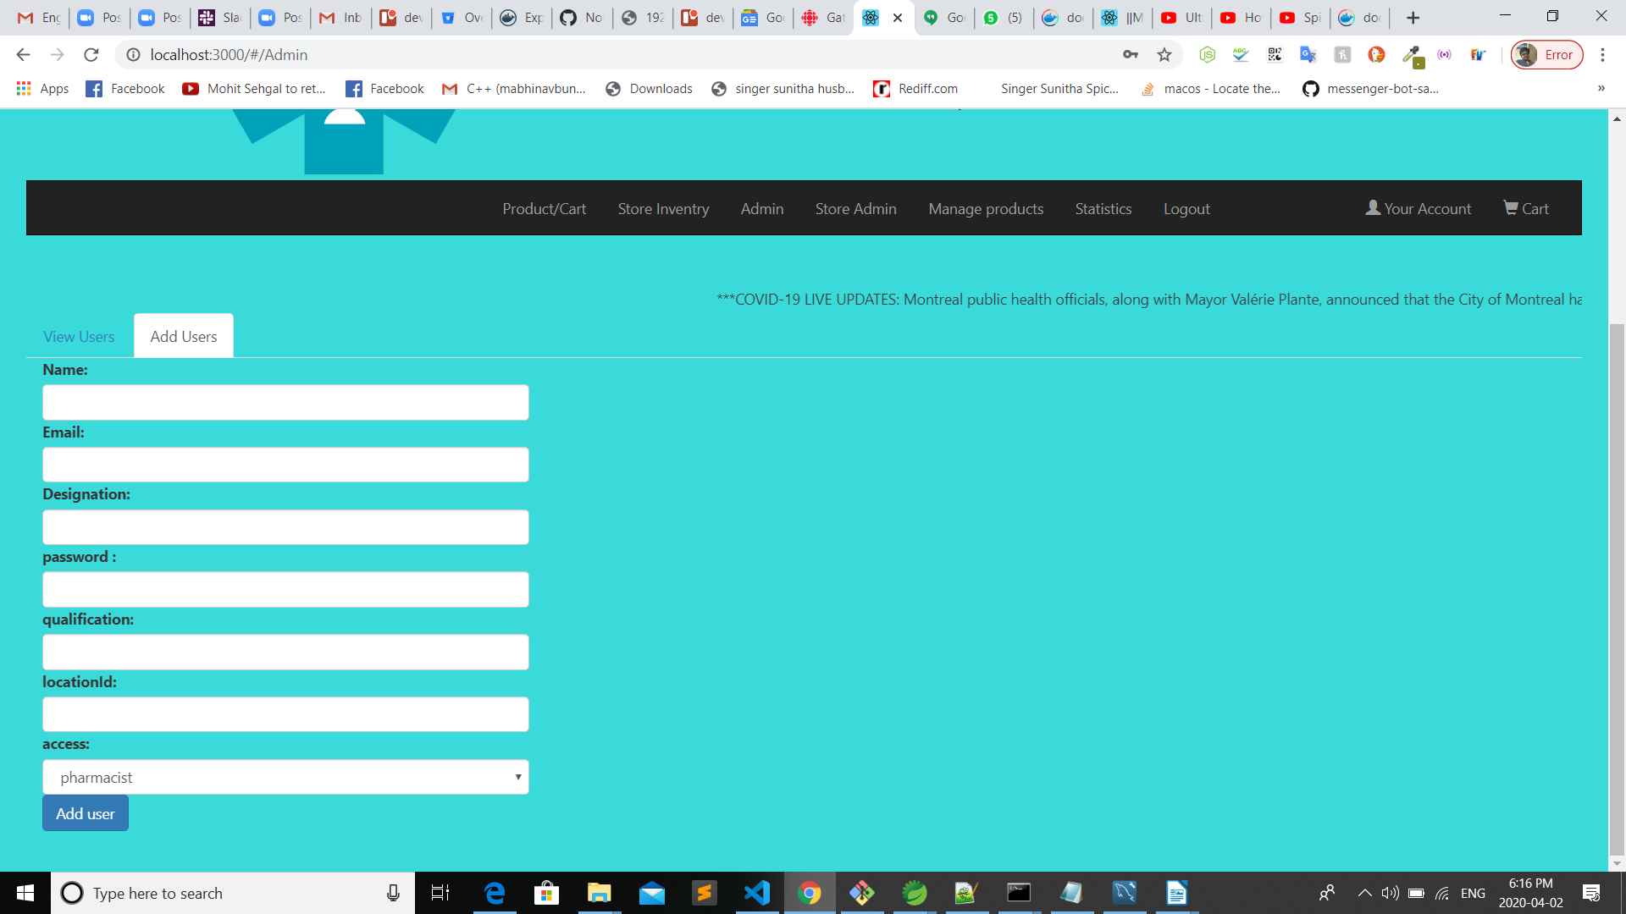
ADMIN PANEL

Slide 14
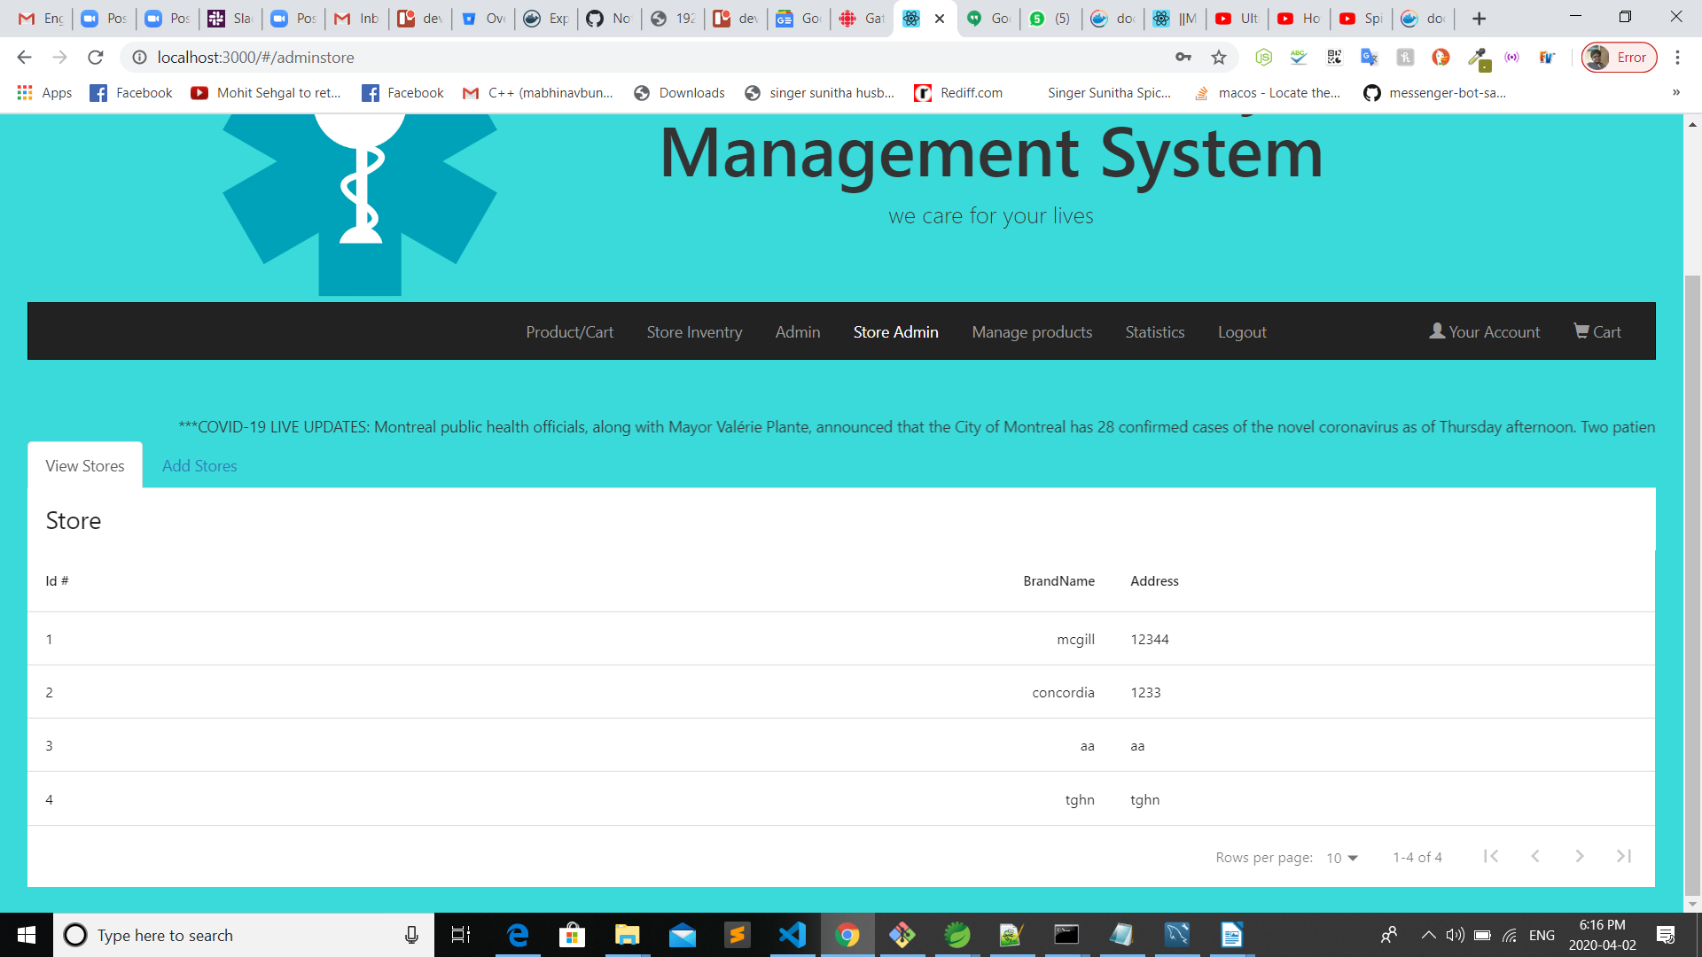
SuperAdmin

Slide 15
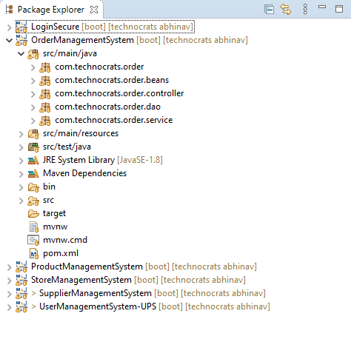
BACKEND code DESIGN

Slide 16
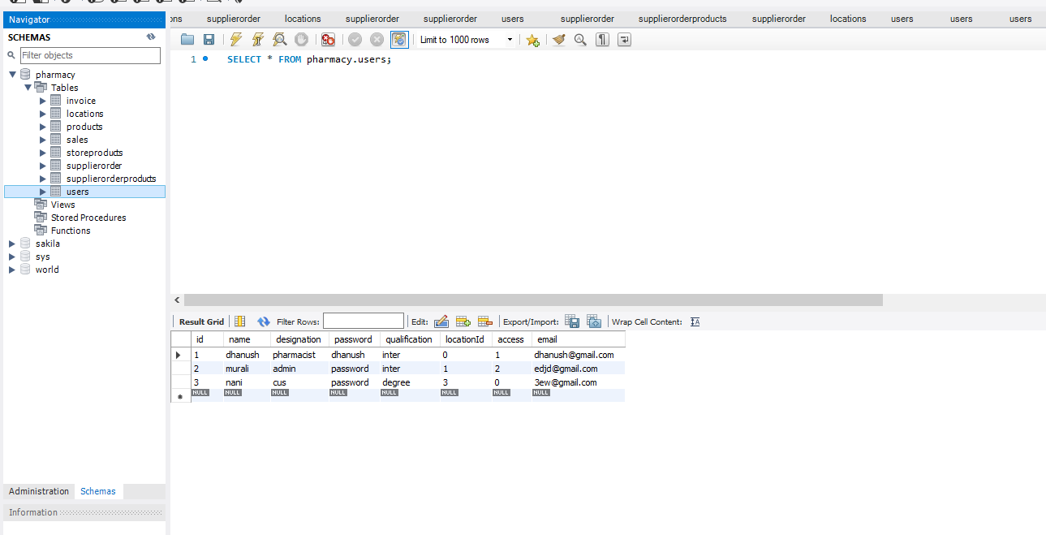

Slide 17

Any Queries

